Slide 1
Visualizing ORACLE performance with R
Maxym Kharchenko
Gluent.com

Slide 2
Whoami
Started as a database kernel developer
Then: ORACLE DBA for 15+ years
Now: Developer at Gluent (past: amazon.com)
OCM, ORACLE Ace Associate, AWS Certified Developer
Blog: http://intermediatesql.com
Twitter: @maxymkh

Slide 3



The cool things that I do (at Gluent)
App Z
We glue these worlds together!
MSSQL
App Y
App X
Gluent
Big Data Sources
Oracle
NoSQL
Teradata

Slide 4
The cool things that I do (at Gluent)

Slide 5
Agenda
Why visualize with R
How to visualize with R
Pretty pictures !
Interesting use cases (more pretty pictures!)
Labs! Labs! Labs!

Slide 6

Why visualize ?
Humans suck
At numbers

Slide 7
Why visualize ?
[1] 10.06 10.07 9.99 9.95 10.56 9.82 10.06 9.97 9.97 9.91
[11] 9.99 10.68 10.04 10.05 9.92 10.08 9.91 9.97 10.11 10.03
[21] 10.08 10.22 8.84 10.42 8.68 10.14 9.46 9.69 11.56 9.55
[31] 10.32 8.77 10.20 10.16 10.03 10.05 10.47 9.83 10.18 10.00
[41] 10.11 9.76 9.89 10.09 10.09 10.15 9.86 10.06 10.56 9.87
[51] 9.95 10.19 10.01 10.04 10.93 11.03 11.07 11.08 11.21 10.77
[61] 11.01 10.87 11.06 11.16 10.94 9.82 10.09 10.16 10.05 9.87
[71] 10.01 9.92 9.90 10.23 10.14 10.09 10.08 9.92 10.05 10.60
[81] 10.06 10.10 9.97 10.25 10.10 10.19 10.07 9.97 10.05 10.08
[91] 9.90 10.41 10.19 9.96 9.90 10.07 9.95 10.22 9.94 9.93
Notes:
set.seed(12345)
d <- data.frame(x=1:100, y=round(rnorm(mean=10, sd=0.1, n=100), 2))
# ggplot(d, aes(x, y, group=1)) + geom_line() + scale_y_continuous(limits=c(0, 20))
d[55:65, ]$y <- d[55:65, ]$y + 1
d[c(5, 12, 25, 37, 49, 80, 92), ]$y <- d[c(5, 12, 25, 37, 49, 80, 92), ]$y + 0.5
d[22:32, ]$y <- round(rnorm(mean=10, sd=1, n=11), 2)
ggplot(d, aes(x, y, group=1)) + geom_line(size=1, color="red") + scale_y_continuous(limits=c(0, 20)) +
theme_minimal() + theme(axis.title.x=element_blank(), axis.title.y=element_blank())

Slide 8
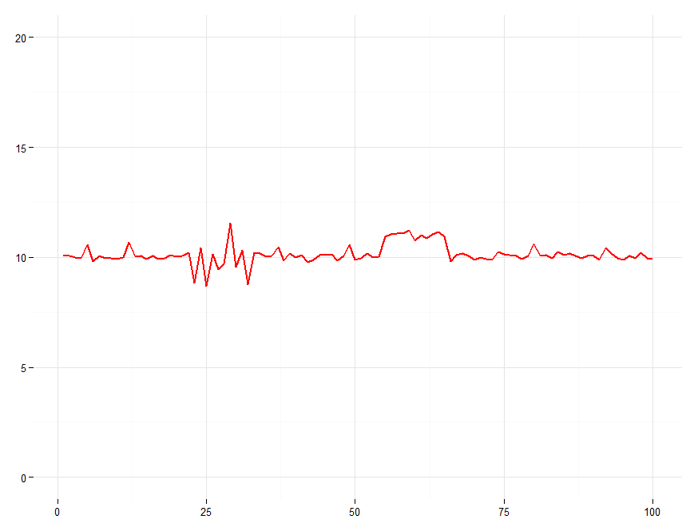
Why visualize ?

Slide 9
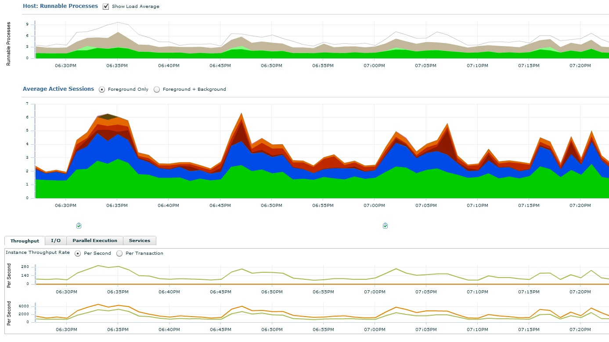
DBA 2.0: EM – Pretty

Slide 10

DBA 2.0: EM – Pretty … but not flexible

Slide 11
DBA 1.0: sqlplus – Flexible
SQL*Plus: Release 11.2.0.2.0 Production on Fri Feb 14
Connected to:
Oracle Database 11g Enterprise Edition Release 11.2.0.2.0
With the Partitioning and Real Application Testing options
SQL> @event_histograms db%file%sequential

Slide 12
DBA 1.0: sqlplus – Flexible … but not pretty
EVENT Ms PCT GRAPH
----------------------- ---- ------- --------------------
db file sequential read 1 18.43 ########
2 4.09 #
4 23.52 ##########
8 43.04 ####################
16 10.05 ####
32 .72
64 .06
128 .09
256 .01
Notes:
define EVENT=&1
define SECONDS=&2
set verify off
colu event format a30
colu wait_time_milli format 99,999 heading 'Wait|Milli'
colu graph format a20
colu pct format 999.99
break on event
with target_data as (
select event, wait_time_milli, wait_count * -1 as wait_count, last_update_time
from v$event_histogram
where event like '%&EVENT%'
union all
select null as event, null as wait_time_milli,
nullif(admin.sleep(&SECONDS), &SECONDS) as wait_count, null from dual
union all
select event, wait_time_milli, wait_count as wait_count, last_update_time
from v$event_histogram
where event like '%&EVENT%'
), analytic_data as (
select event, wait_time_milli, sum(wait_count) as wait_count,
sum(wait_count)/sum(sum(wait_count)) over (partition by event) as pct_sum,
max(last_update_time) as last_update_time
from target_data
group by event, wait_time_milli
having sum(wait_count) > 0
)
select event, wait_time_milli,
round(pct_sum * 100, 2) as pct,
lpad('#', pct_sum/max(pct_sum) over (partition by event) * 20, '#') as graph
from analytic_data
order by event, wait_time_milli
/
undef EVENT
undef SECONDS

Slide 13
DBA 1.0: sqlplus – Flexible … but not pretty
EVENT Ms PCT GRAPH
----------------------- ---- ------- --------------------
db file sequential read 1 18.43 ********
2 4.09 *
4 23.52 **********
8 43.04 ********************
16 10.05 ****
32 .72
64 .06
128 .09
256 .01
Notes:
define EVENT=&1
define SECONDS=&2
set verify off
colu event format a30
colu wait_time_milli format 99,999 heading 'Wait|Milli'
colu graph format a20
colu pct format 999.99
break on event
with target_data as (
select event, wait_time_milli, wait_count * -1 as wait_count, last_update_time
from v$event_histogram
where event like '%&EVENT%'
union all
select null as event, null as wait_time_milli,
nullif(admin.sleep(&SECONDS), &SECONDS) as wait_count, null from dual
union all
select event, wait_time_milli, wait_count as wait_count, last_update_time
from v$event_histogram
where event like '%&EVENT%'
), analytic_data as (
select event, wait_time_milli, sum(wait_count) as wait_count,
sum(wait_count)/sum(sum(wait_count)) over (partition by event) as pct_sum,
max(last_update_time) as last_update_time
from target_data
group by event, wait_time_milli
having sum(wait_count) > 0
)
select event, wait_time_milli,
round(pct_sum * 100, 2) as pct,
lpad('#', pct_sum/max(pct_sum) over (partition by event) * 20, '#') as graph
from analytic_data
order by event, wait_time_milli
/
undef EVENT
undef SECONDS

Slide 14
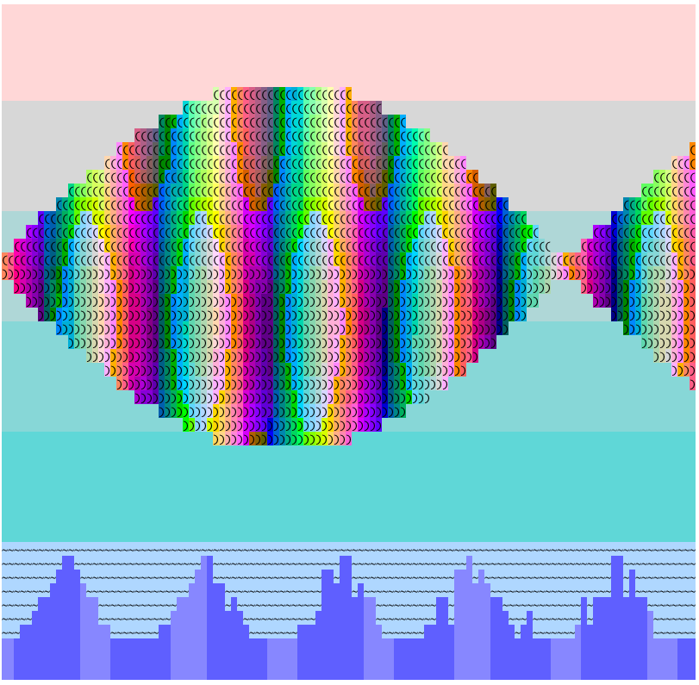
Ok, sqlplus CAN be pretty
Tanel Poder’s fish.sql

Slide 15
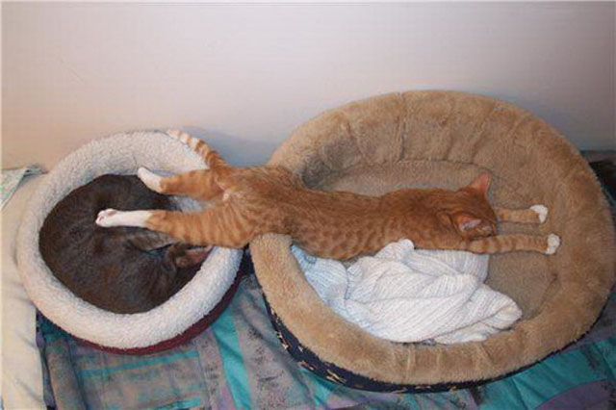
Need a tool: both pretty AND flexible

Slide 16

DBA 1.5: Enter R

Slide 17
How to visualize data with R

Slide 18
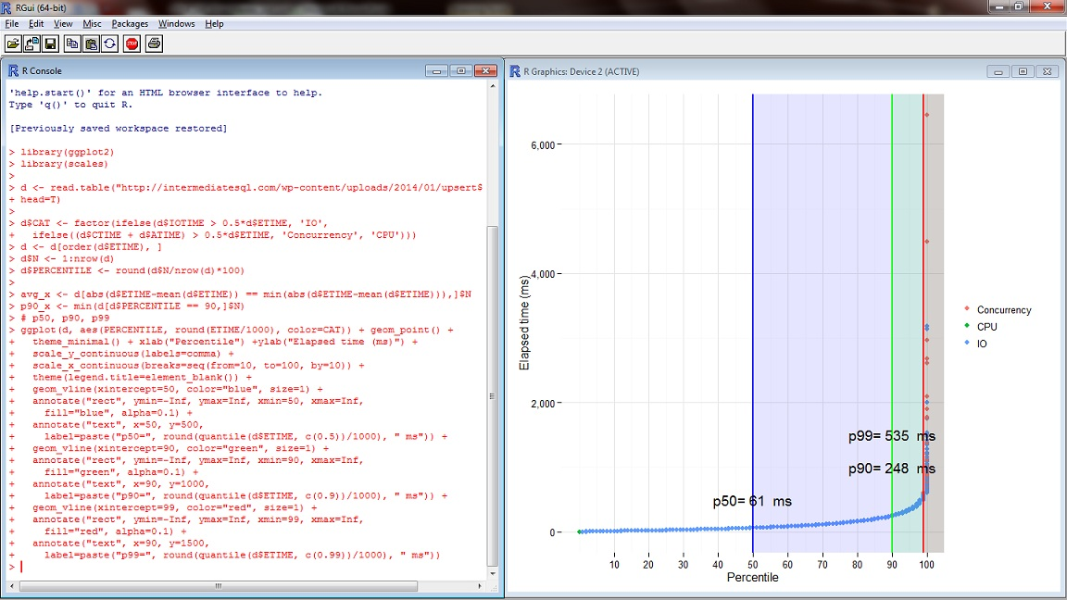
What R looks like
http://www.r-project.org/

Slide 19
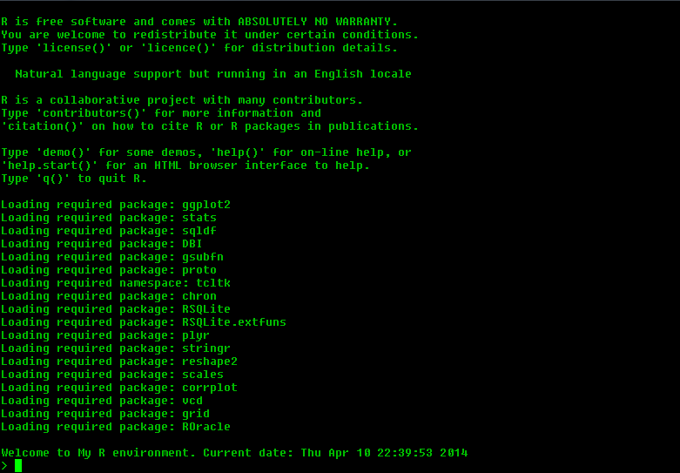
What R looks like

Slide 20
If you know how to program in Perl/Python/Ruby etc
You know how to program in R

Slide 21
#***********************************************************
# Prepare exploration: Define categories, set plot type etc
#***********************************************************
prepare_exploration <- function(
fill=NULL, y="N", x="TS", pct=FALSE,
to_ts=c("TS"), top_n=8, drop_others=FALSE, data=d
) {
if(is.null(fill)) {
data$CAT <- 1
} else {
data <- add_cat_top_n(fill, y, x, top_n, drop_others, data)
if (pct) {
data <- add_pct(y, x, data)
}
}
data <- to_ts(to_ts, data)
return(data)
}

Slide 22


R: Appearances are important
A = B + C
A <- B + C

Slide 23
R: Everything is a VECTOR
A + B
Result:
[1] 4 6 8 10 12 14 16 18 20 22

Slide 24
R visualization workflow
Get data into R
Transform
Visualize

Slide 25
Get data into R
CSV, TXT:
d <- read.csv('http://…/file.csv')
ROracle, RJDBC:
odrv <- dbDriver("Oracle")
conn <- dbConnect(odrv, user, passwd, tns)
d <- dbGetQuery(conn, sql, binds)

Slide 26
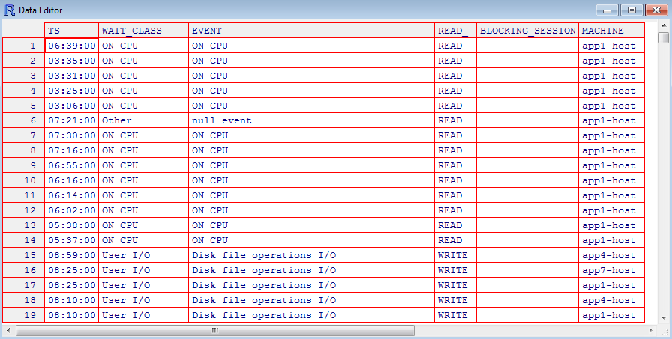
Data in R - a “data frame”

Slide 27
Transform
If you know SQL
You know how to transform data in R

Slide 28
Transform
d1 <- sqldf("
SELECT event, count(1) as n
FROM d
GROUP BY event
ORDER BY n DESC LIMIT 10
")

Slide 29
Visualize
ggplot(d, aes) + geom
+ “other stuff”

Slide 30
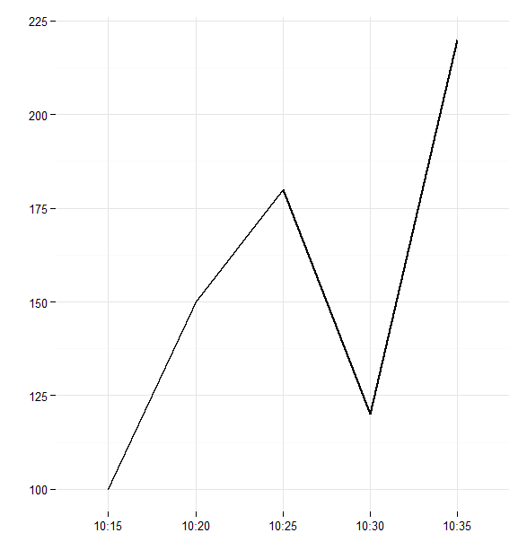
AES: Mapping data
Time | Execs
10:15 | 100
10:20 | 150
10:25 | 180
10:30 | 120
10:35 | 220
aes(x=Time, y=Execs)

Slide 31
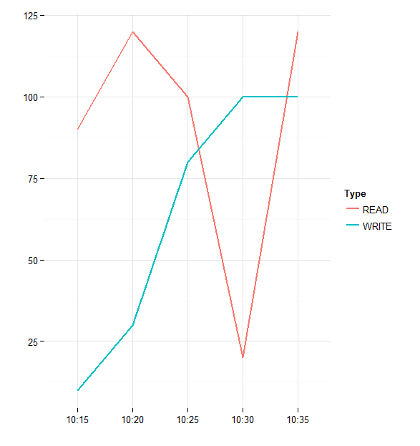
AES: Mapping data
Time | Execs | Type
10:15 | 90 | READ
10:15 | 10 | WRITE
10:20 | 120 | READ
10:20 | 30 | WRITE
10:25 | 100 | READ
10:25 | 80 | WRITE
10:30 | 20 | READ
10:30 | 100 | WRITE
10:35 | 120 | READ
10:35 | 100 | WRITE
aes(x=Time, y=Execs, color=Type)

Slide 32
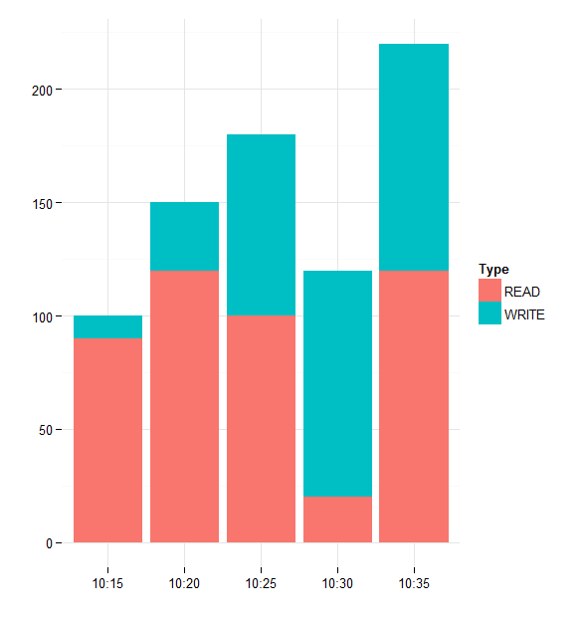
Geoms
Time | Execs | Type
10:15 | 90 | READ
10:15 | 10 | WRITE
10:20 | 120 | READ
10:20 | 30 | WRITE
10:25 | 100 | READ
10:25 | 80 | WRITE
10:30 | 20 | READ
10:30 | 100 | WRITE
10:35 | 120 | READ
10:35 | 100 | WRITE
aes(x=Time, y=Execs, fill=Type) + geom_bar()

Slide 33
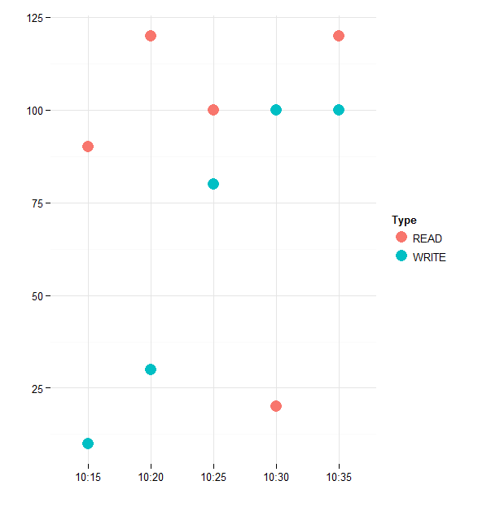
Geoms
Time | Execs | Type
10:15 | 90 | READ
10:15 | 10 | WRITE
10:20 | 120 | READ
10:20 | 30 | WRITE
10:25 | 100 | READ
10:25 | 80 | WRITE
10:30 | 20 | READ
10:30 | 100 | WRITE
10:35 | 120 | READ
10:35 | 100 | WRITE
aes(x=Time, y=Execs, color=Type) + geom_point()

Slide 34
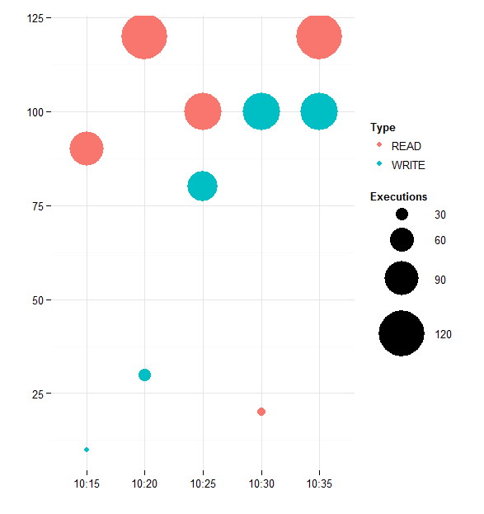
Geoms
Time | Execs | Type
10:15 | 90 | READ
10:15 | 10 | WRITE
10:20 | 120 | READ
10:20 | 30 | WRITE
10:25 | 100 | READ
10:25 | 80 | WRITE
10:30 | 20 | READ
10:30 | 100 | WRITE
10:35 | 120 | READ
10:35 | 100 | WRITE
aes(x=Time, y=Execs, color=Type, size=Execs) + geom_point()

Slide 35
Putting it all together
R> connect('db1')
R> exec('get_ash.sql',start_time='2016-02-01')
R> n_exec('db1, db2, db3', 'get_ash.sql', start_time='2016-02-01')
R> d1 <- sqldf('select … from … where …')
R> explore_bar(fill='EVENT')
R> explore_area(fill='BLOCKING_SESSION')
R> explore_point(x='PARSES', y='EXECS', color='MODULE', top=8)

Slide 36
Picture time !

Slide 37
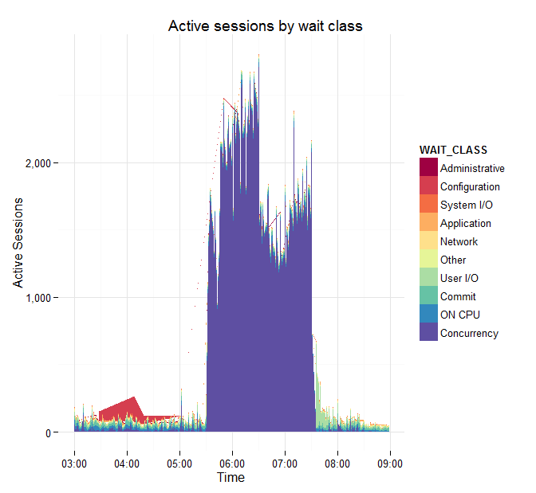
Time series plots: v$active_session_history

Slide 38
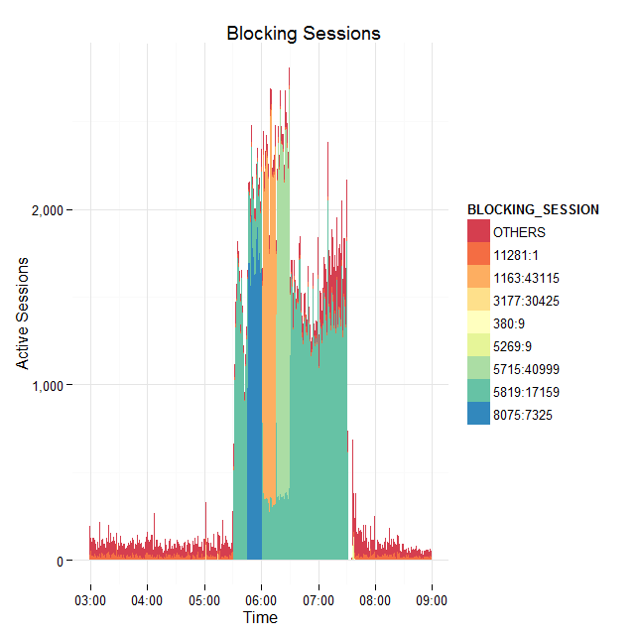
Time series plots: v$active_session_history

Slide 39
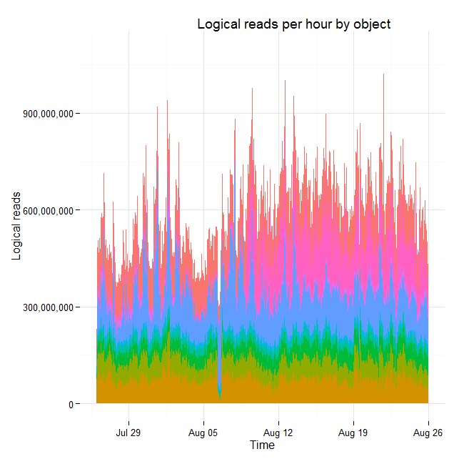
Time series plots: dba_hist_seg_stat

Slide 40
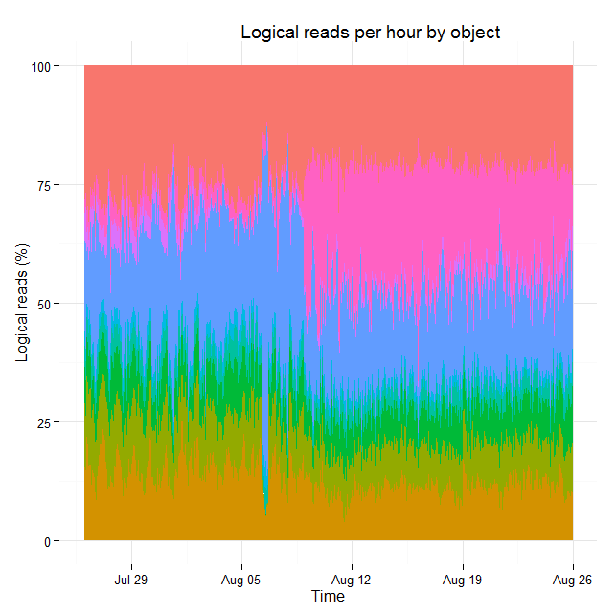
Time series plots: dba_hist_seg_stat

Slide 41
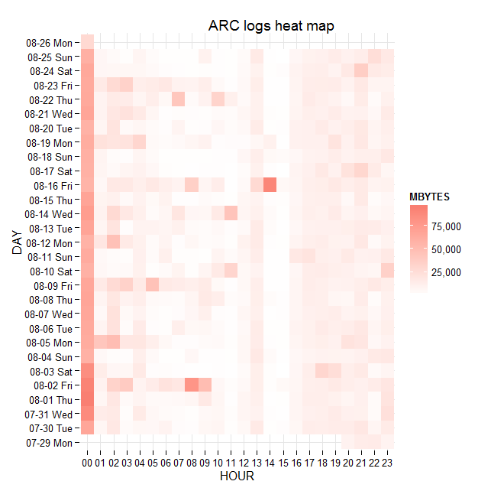
Time series plots – ARC heat map

Slide 42
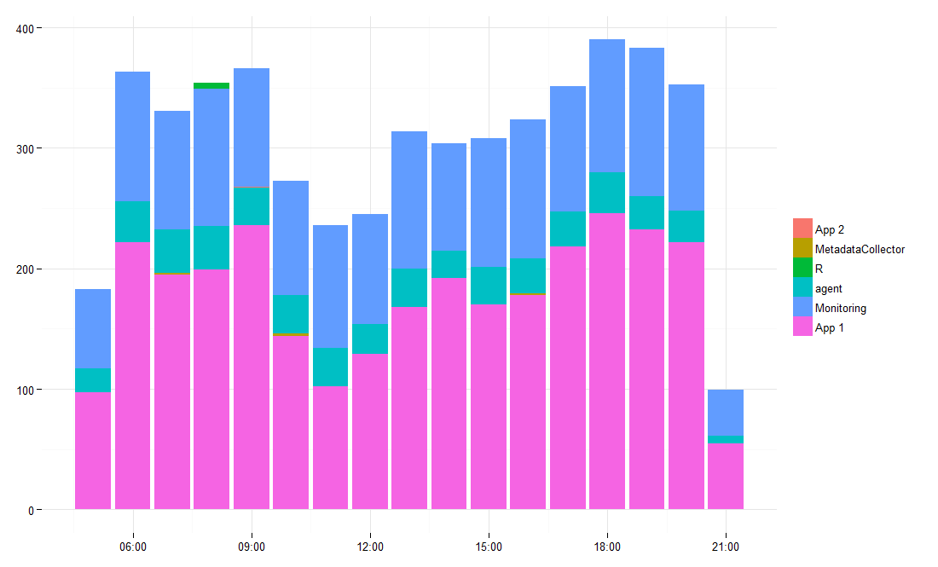
Not just for database metrics
cat listener.log | grep CONNECT_DATA | \ perl -pale 's/^(\S+ \S+).*\(PROGRAM=(.*?)\).*$/$1 $2/' >/tmp/s.txt

Slide 43
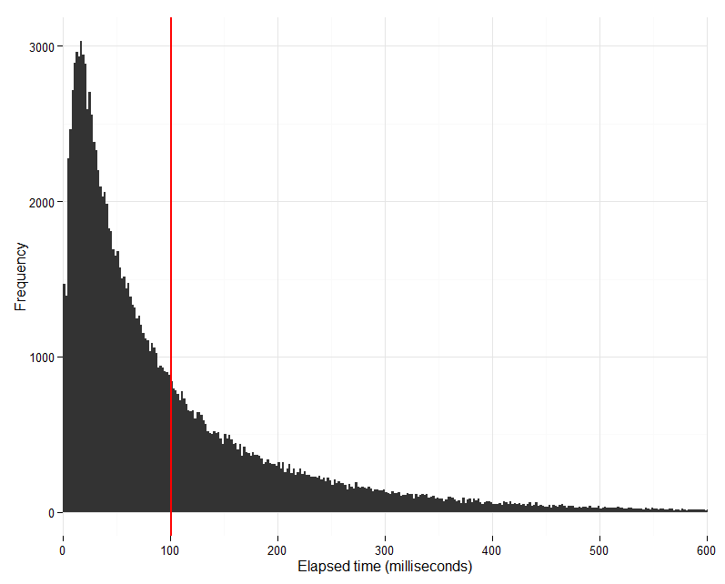
Summarized data: (sampled) v$sql
v$sql.elapsed_time

Slide 44
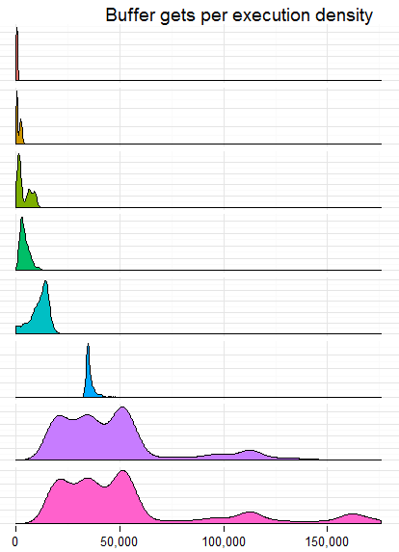
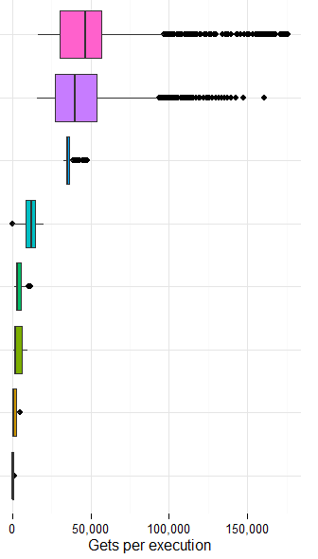
Summarized data: dba_hist_sqlstat

Slide 45
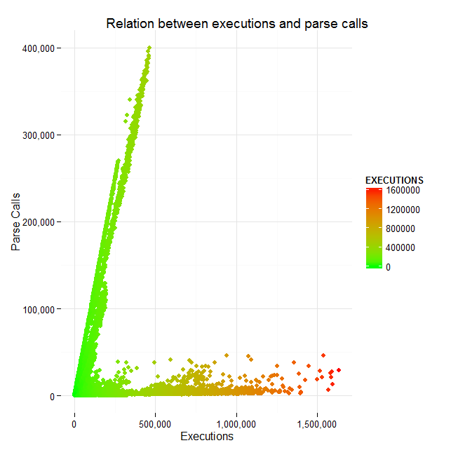
Scatter plots: dba_hist_sqlstat

Slide 46
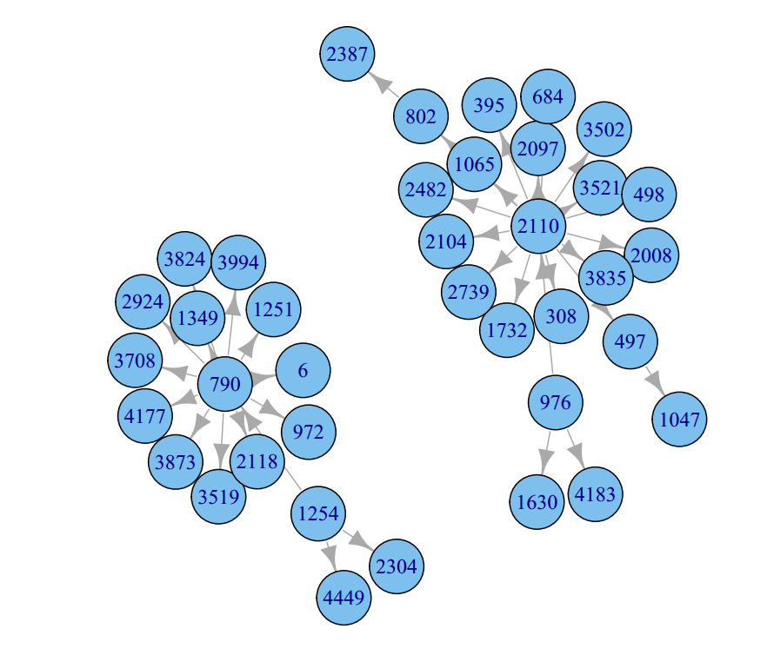
Block flowers: dba_hist_active_sess_history

Slide 47
A few interesting cases

Slide 48
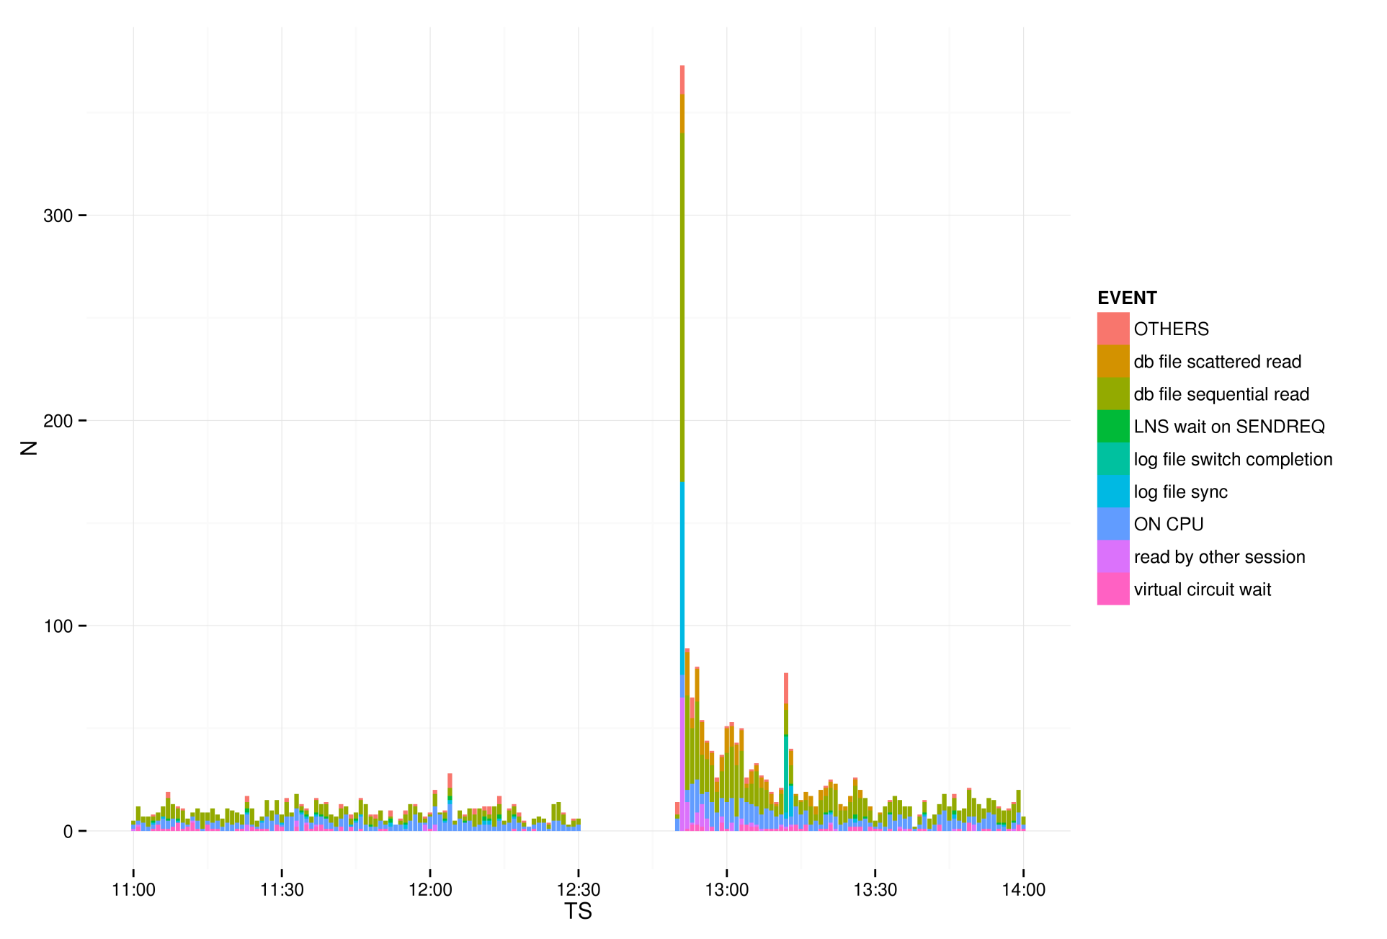
ORA-00020: Max # of processes exceeded When was the database really “down” ?

Slide 49
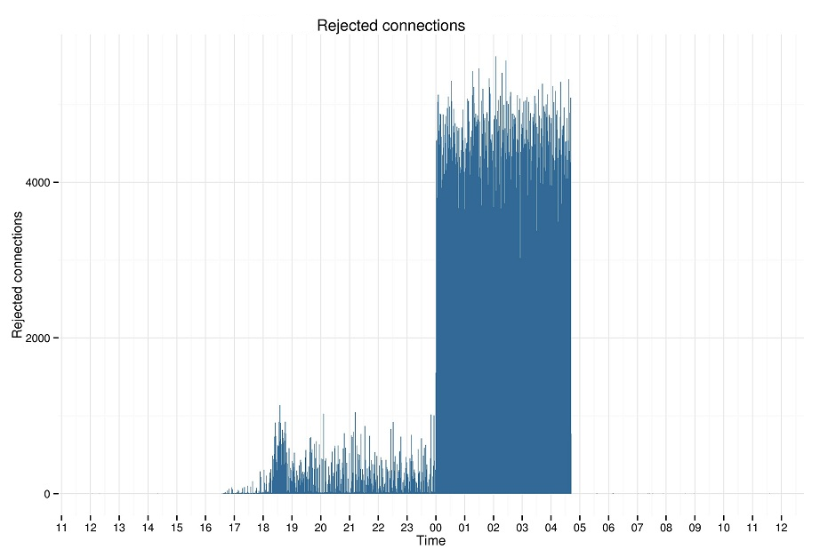
Logon trigger: Rejected connections What was the exact effect on the system ?
ASH.in_connection_mgmt=‘Y’

Slide 50
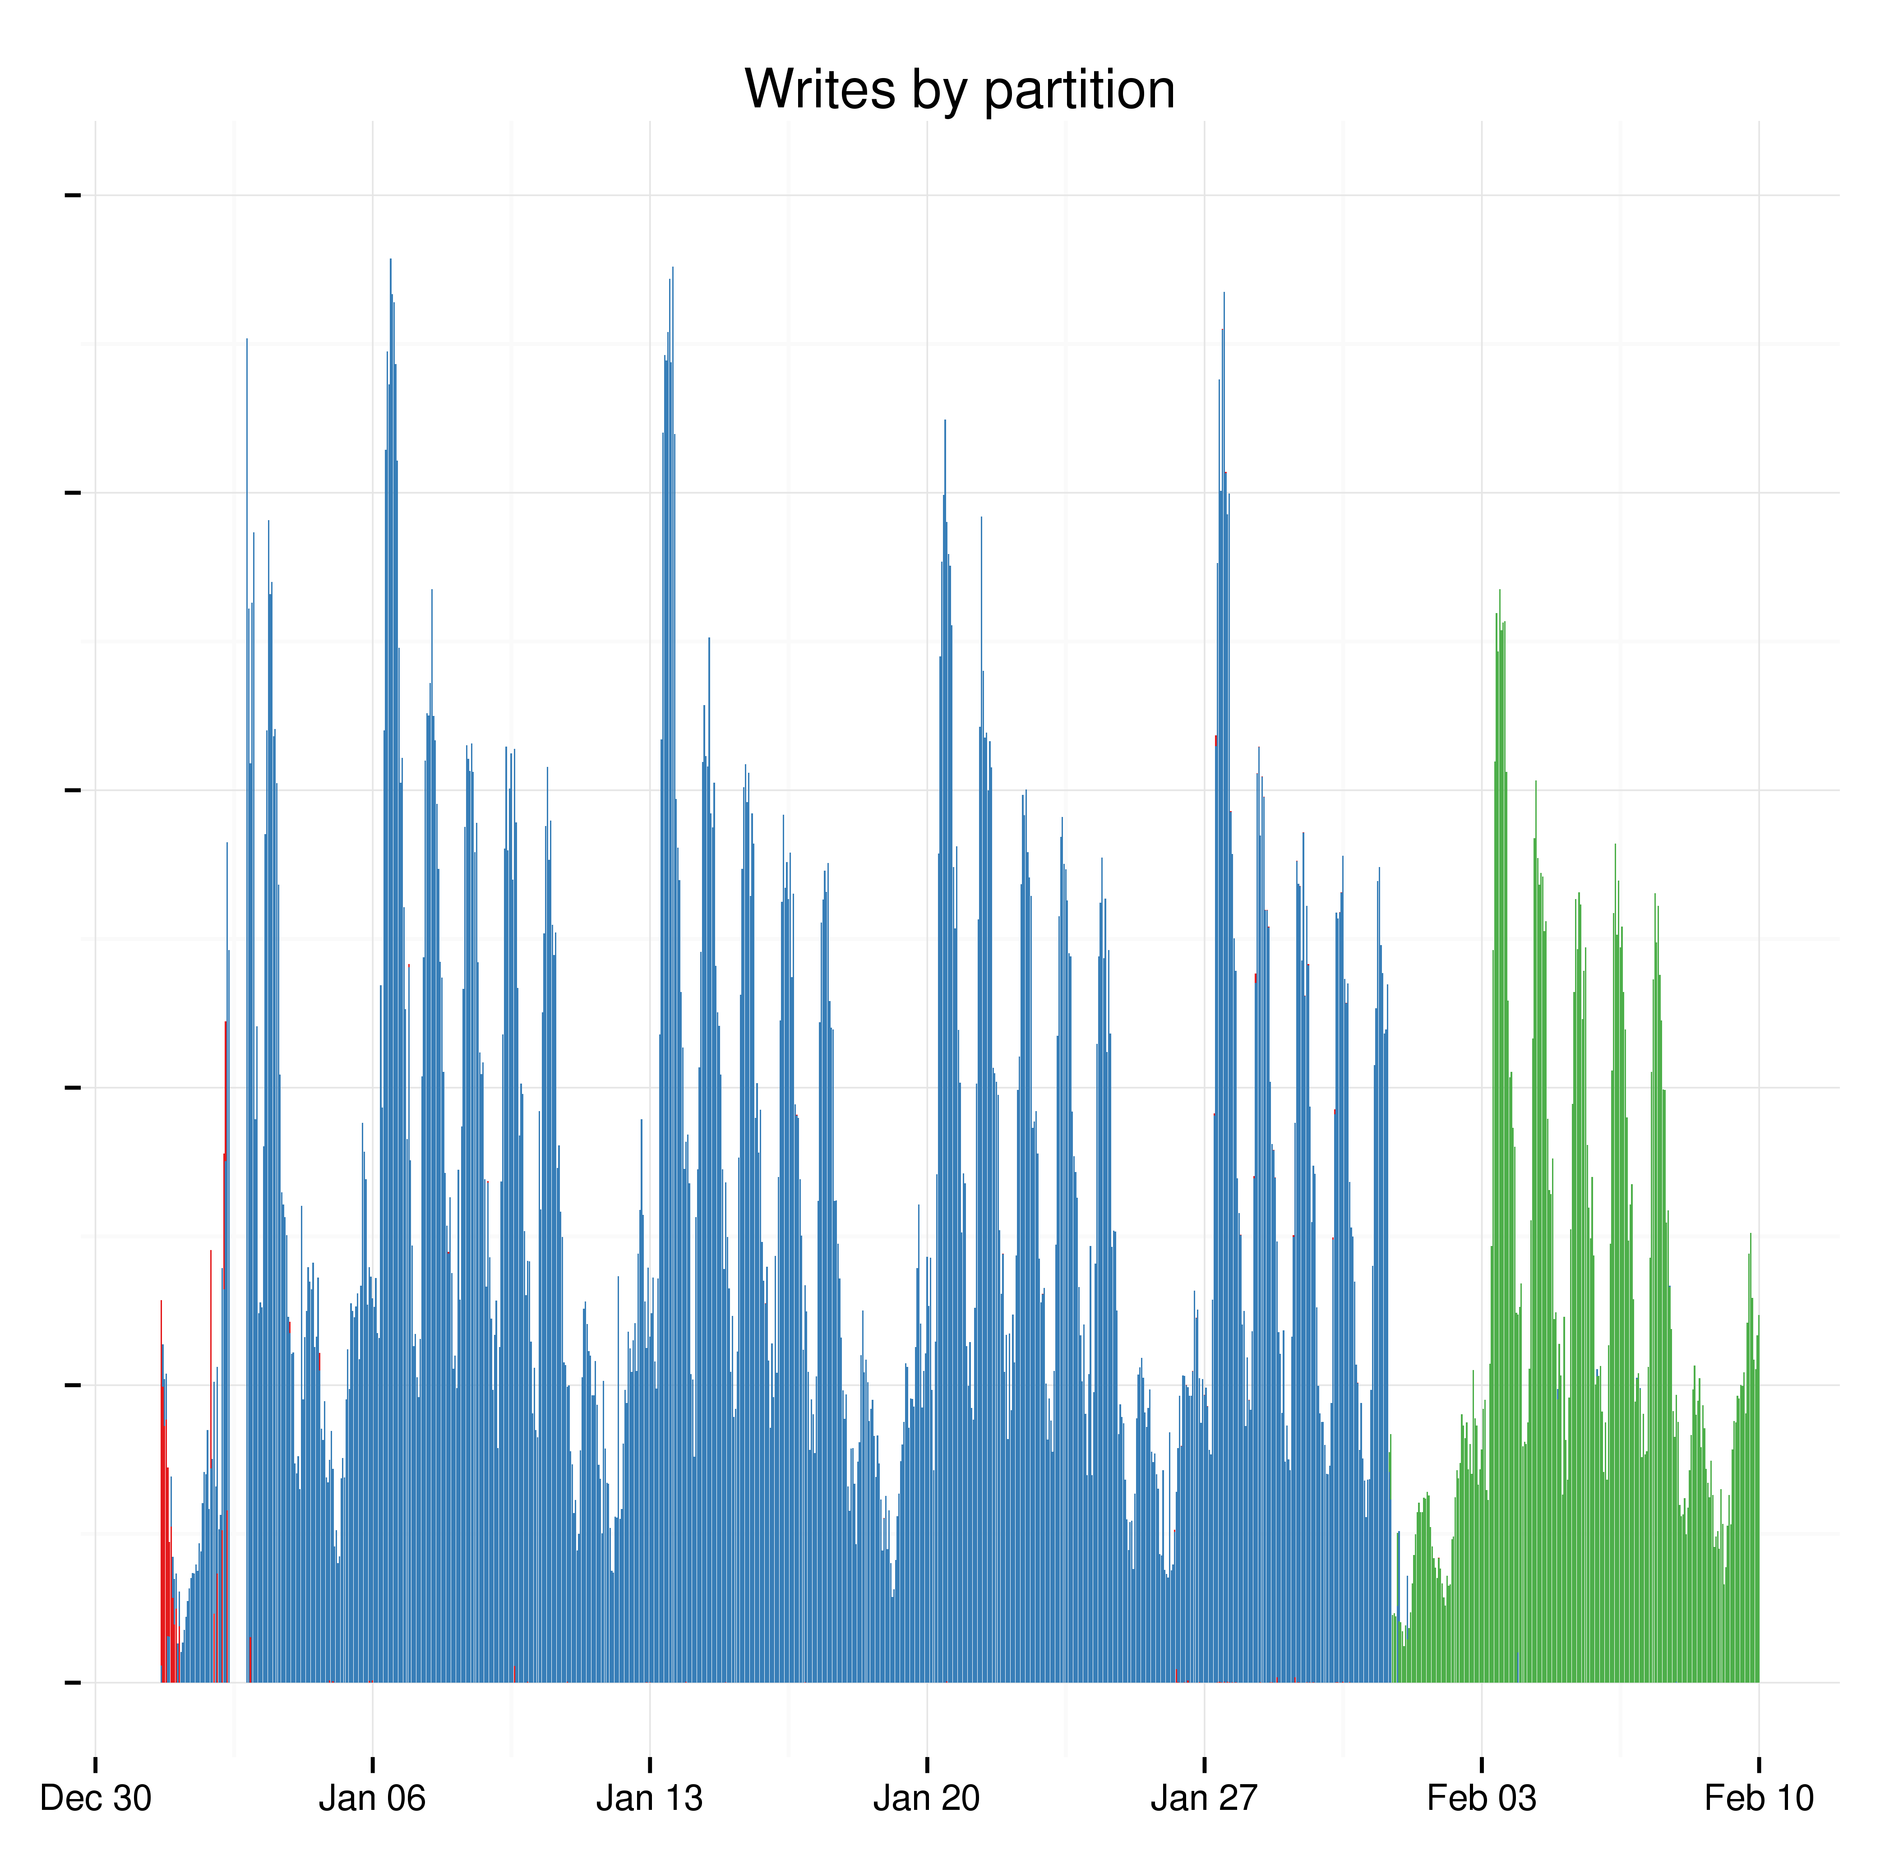
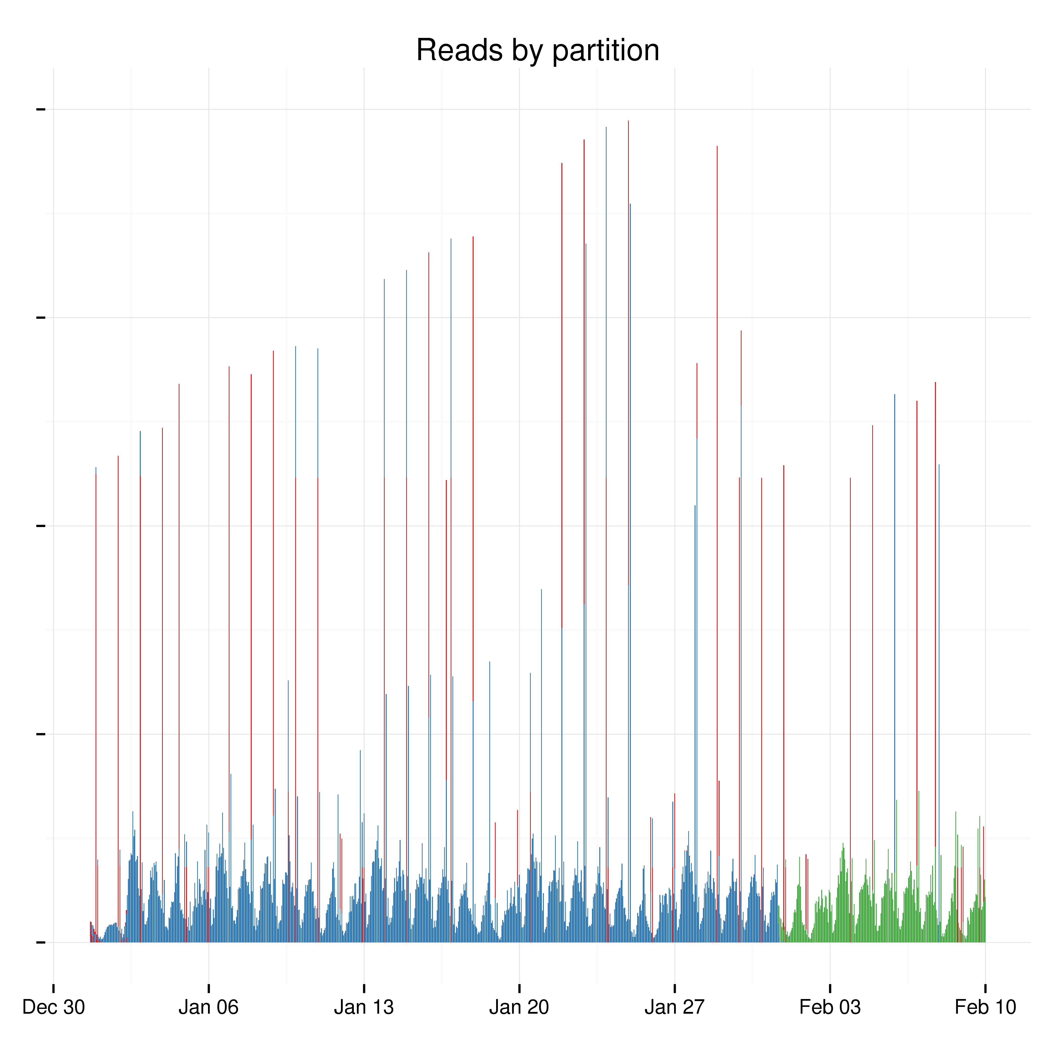
Rolling partitions: Can we archive data older than 30 days ?
dba_hist_seg_stat. db_block_changes_delta
dba_hist_seg_stat. logical_reads_delta

Slide 51
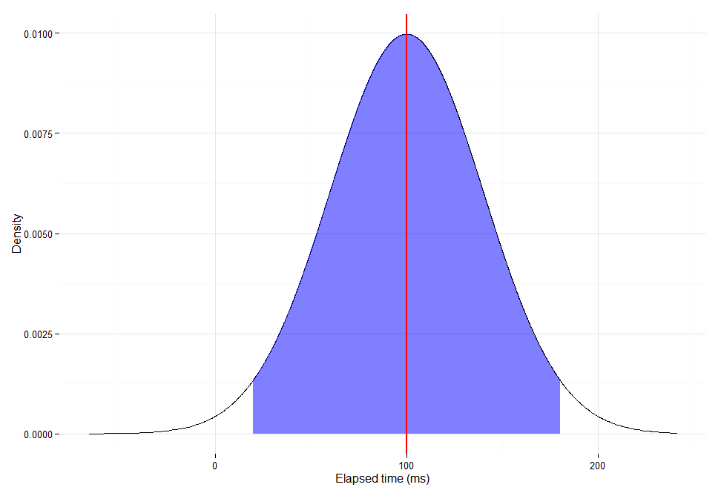
Query latency: Can we trust the “average” elapsed time ?

Slide 52
Query latency: Can we trust the “average” elapsed time ?

Slide 53
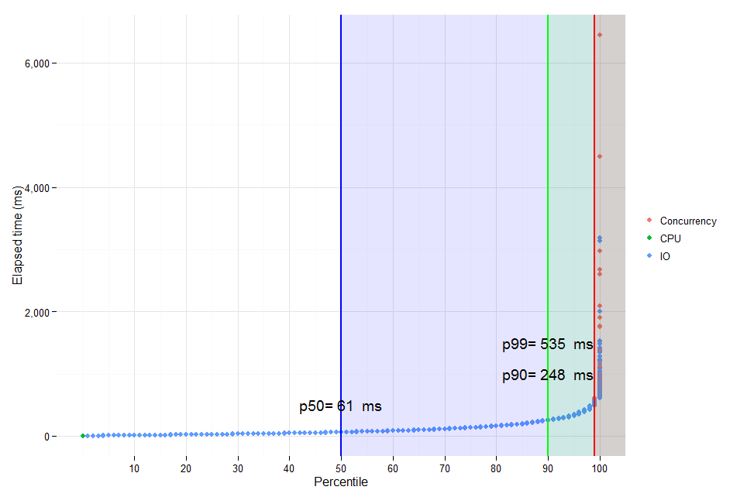
Query latency: Can we trust the “average” elapsed time ?

Slide 54
Takeaways
R is a sqlplus with graphics
If you know how to script, R is easy to master
Did I mention that R is free ?

Slide 55
Thank you! Please complete session evaluation We appreciate your feedback and insight

